Slide 1

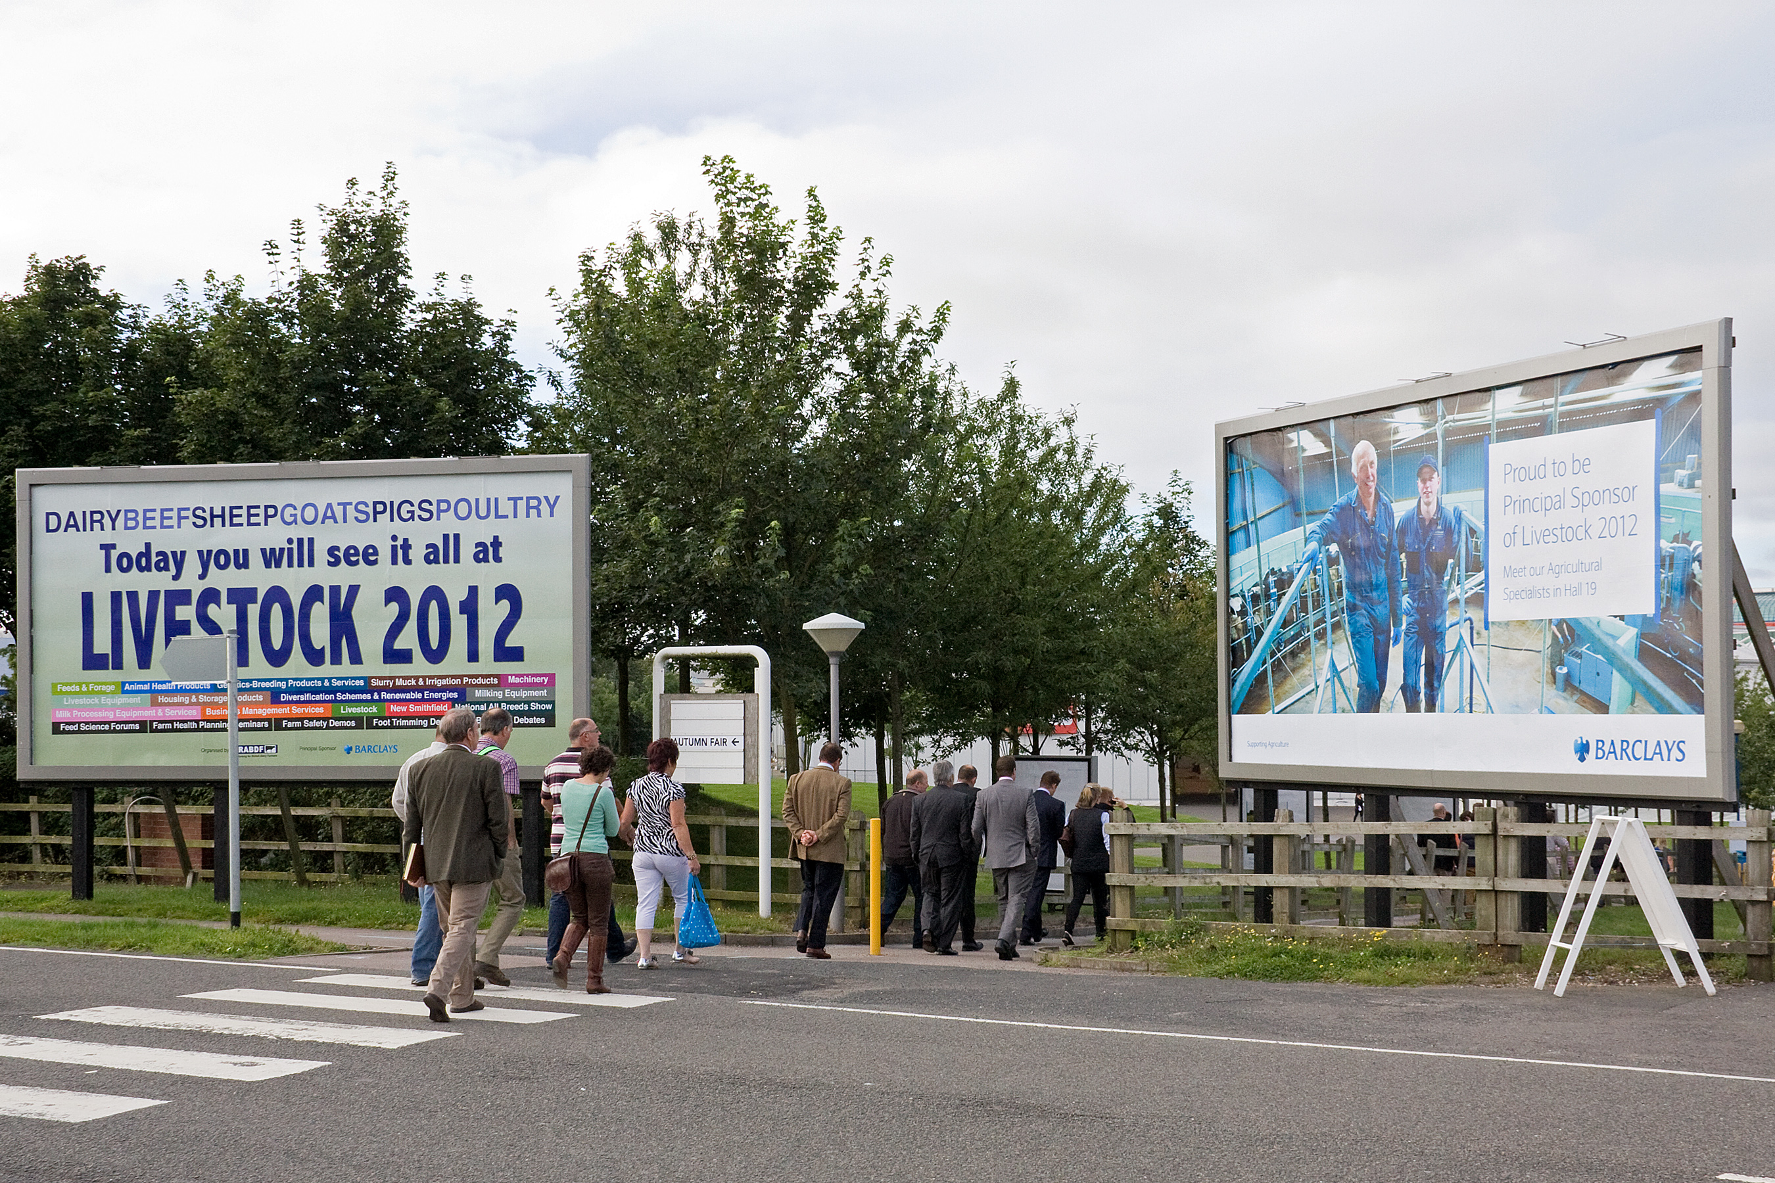
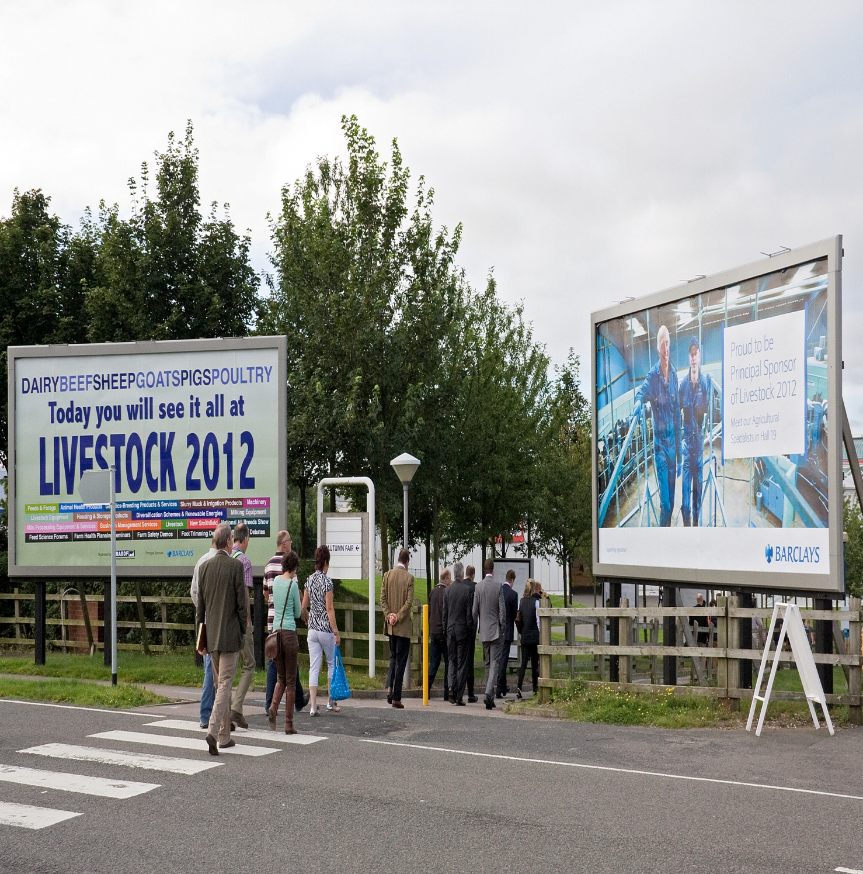


ADVERTISING OPPORTUNITIES
LIVESTOCK EVENT 2014

Slide 2
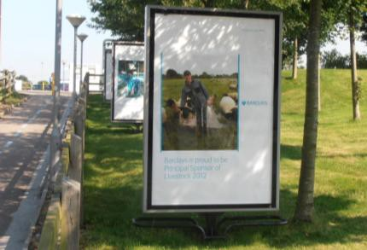
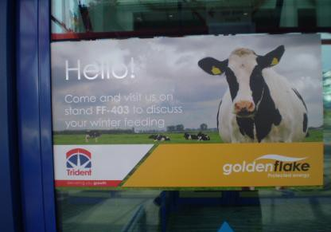

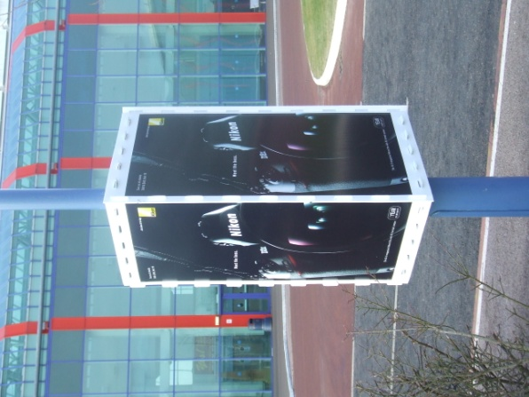
A-Packs, Pedestrian Walkway
4 x double sided units (8 posters in total)
£2,596 plus VAT, cost inclusive of production and installation
Door Gels
Atrium 2 Entrance: 20 doors / 40 gels
£1,916 plus VAT inclusive of production and installation
Atrium 3 Entrance: 28 Doors / 56 Gels
£2,708.60 plus VAT inclusive of production and installation
Billboards on the Main Road
48 sheet wet posted billboards
£1,985 plus VAT, cost inclusive of production and installation
Quantity Available: 4 Billboards
Lampost Tri Signs
Atrium A: 10 of
£32,52 plus VAT inclusive of production and installation
Atrium B: 10 of
£3,252 plus VAT inclusive of production and installation

Slide 3
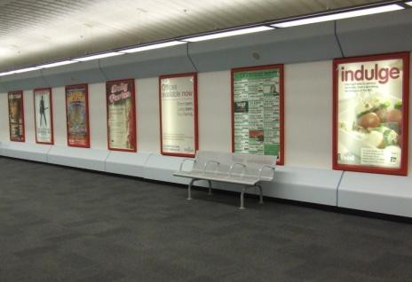
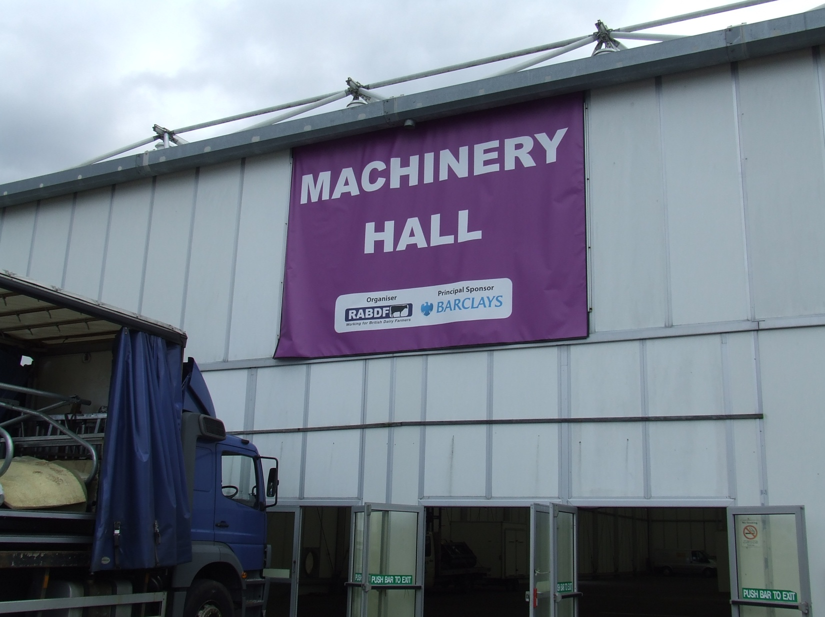
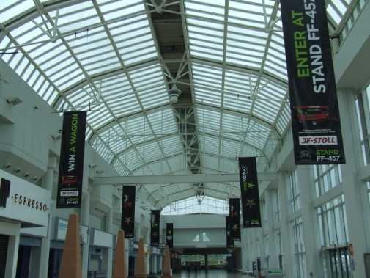
Train Station Bridge-link Posters
Sold in sets of 10
£2,210 plus VAT, cost inclusive of production and installation
Site locations to be confirmed when booking
Hall 16 Banners
£1,671 plus VAT, cost inclusive of production and installation
Site locations to be confirmed when booking
Atrium Hanging Pendant Banners x 8
£5,308 plus VAT, cost inclusive of production and installation
Site locations to be confirmed when booking
For more information please contact:
Kate Jones
Business Development Manager
Tel: 0845 458 2711
E-mail: katejones@rabdf.co.uk
All prices quoted exclude VAT. All media is subject to availability at time of event. Full production specification available on request.

